Slide 1



Area Agency on Aging
Trauma-Informed Self-Care

Slide 2

Presenters
Marissa Peterson
B.S. Psychology - John Carroll University
M.S. Counseling Psychology - Frostburg State University
Licensed Professional Counselor
Rebecca Nowlin
B.A. Psychology - University of Missouri
M.Ed. Counseling - Stephens College
Licensed Professional Counselor

Slide 3
Trauma
Any disturbing experience that results in significant fear, helplessness, dissociation, confusion, or other disruptive feelings intense enough to have a long-lasting negative effect on a person’s attitudes, behavior, and other aspects of functioning.
Traumatic events include those caused by human behavior (e.g., rape,
war, industrial accidents) as well as by nature (e.g., earthquakes) and
often challenge an individual’s view of the world as a just, safe,
and predictable place.
American Psychological Association
www.apa.org/topics/trauma

Slide 4
Traumatic Experiences
Poverty
Neglect
Physical, sexual, and emotional abuse
Violence in the community, war, or terrorism
Sudden, unexplained separation from a loved one
Racism, discrimination, and oppression
Living with a family member with mental health or substance use disorders
Trauma-Informed Care Implementation Resource Center
traumainformedcare.chcs.org/what-is-trauma/

Slide 5
Vicarious Trauma/Secondary Trauma
American Psychological Association (apa.org/topics/trauma)
The impact on a helping professional of repeated emotionally intimate contact with trauma survivors. Vicarious Trauma affects helping professionals across clients and situations. It results in a change in the helping professional’s own worldview and sense of the justness and safety of the world. A helping professional’s isolation and overinvolvement in trauma work can increase the risk of vicarious
traumatization.
Cleveland Clinic (health.clevelandclinic.org/vicarious-trauma)
Vicarious trauma is the experience of absorbing others’ pain in
times of their distress so deeply that it affects your own well-being.

Slide 6
Vicarious Trauma Experiences
Listening to client’s experiences of abuse, violence, or illness
Responding to scenes of accidents, disasters, or crimes
Reporting on traumatic events
Supporting loved ones who have experienced trauma
Witnessing graphic depictions of violence or trauma in the news or entertainment
Hearing stories from friends, family, or colleagues who have experienced trauma

Slide 7
Signs & Symptoms of Vicarious Trauma
Reduced sense of value at work
Concentration and focus problems
Apathy and emotional numbness
Isolation and withdrawal
Exhaustion
Jaded, bitter pessimism
Secretive addictions and self-medicating
Risk Factors for Vicarious Trauma
New to a helping profession
History of personal trauma or burnout
Work long hours and/or have large caseloads
Inadequate support systems (Professional & Personal)
Crisis Prevention Institute
www.crisisprevention.com

Slide 8
Trauma-Informed Care
A framework of thinking and interventions that are directed by a thorough understanding of the profound neurological, biological, psychological, and social effects trauma has on an individual—recognizing that person’s constant interdependent needs for safety, connections, and ways to manage emotions/impulses.
Guiding Principles
Safety
Trustworthiness & Transparency
Peer Support
Collaboration & Mutuality
Empowerment & Choice
Cultural, Historical, Racial & Gender Issues
Crisis Prevention Institute
www.crisisprevention.com

Slide 9
Trauma-Informed Self-Care
Awareness: Being attuned to one’s needs, limits, emotions, and resources; practicing self-acceptance
Balance: Maintain work/life balance; making time for work, play, and rest
Connection: Maintaining supportive relationships
Wisconsin Department of Health Services
www.dhs.wisconsin.gov/non-dhs/dph/062019ticandsc.pdf

Slide 10
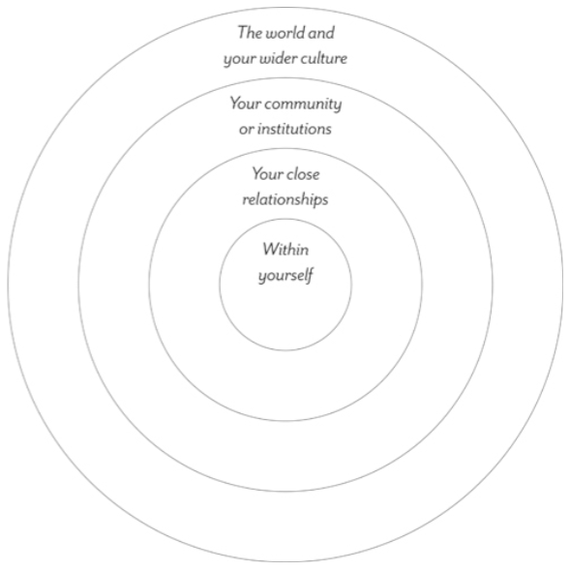
Barriers to Self-Care
Within Yourself: We need to something now, not take time out for bubble baths!
Your Close Relationships: Terrible things are happening to people, I need to focus on them, not me.
Your Community or Institutions: My community is suffering, and I just can’t slow down right now.
The World and Your Wider Culture: I’m finally realizing how much people like me - and the systems that privilege us - are part of the problem. I don’t deserve self care. Everyone looking out for number one is what got us into this mess.
Hell Yeah Self-Care! A Trauma-Informed Workbook
Alex Iantaffi and Meg-John Barker (2021)

Slide 11
Challenge Barriers to Self-Care
Caring for myself is not self-indulgence. It is an act of self-preservation and that is an act of political warfare.
-Audre Lorde, American Writer and Professor
Hell Yeah Self-Care! A Trauma-Informed Workbook
Alex Iantaffi and Meg-John Barker (2021)

Slide 12
Self-Care for Awareness
Goal: Being attuned to one’s needs, limits, emotions, and resources; practicing self-acceptance
Meditation: Mindfulness, Breathing, Prayer Bowl
Journaling: Write about feelings and experiences
Self-Reflection: Identify supports and triggers

Slide 13
Self-Care for Balance
Goal: Maintain work/life balance; making time for work, play, and rest
Health: Exercise, nutrition, sleep
Hobbies: Engage in favorite hobbies, find new hobbies
Time Management: Schedule breaks, meal prep

Slide 14
Self-Care for Connection
Goal: Maintaining supportive relationships
Friends: Coffee, game night
Volunteer: Food pantry, animal shelter
Classes/Groups: Cooking class, book club, sports, nature

Slide 15
Permission
Give yourself permission to:
Say no to activities/events that aren’t restorative
End relationships that keep you from thriving
Take a social media break
Set boundaries
Change your mind

Slide 16
Contact Information
Phone: (800) 369-5211
Email: mpeterson@agingbest.org
rnowlin@agingbest.org
Website: www.agingbest.org

Slide 17
Thank You

