Slide 1
Bringing Age-friendly Care to Your Community: Four Must-know Words
Hedva Barenholtz Levy PharmD, BCPS, BCGP
Director, HbL PharmaConsulting, St. Louis, MO
Age-friendly Pharmacist

Slide 2
Outline for Today
Age-friendly Health Systems Movement
Empowering clients
4Ms Framework
Applying the 4Ms
Advocate

Slide 3
Age-friendly Health Systems Movement
Developed 2017
Institute for Healthcare Improvement (IHI) and John A. Hartford Foundation
In partnership with the American Hospital Association and the Catholic Health Association of the United States.
Purpose: To improve care among older adults, avoid harm, increase satisfaction of care received
Age-friendly Health Systems
4Ms Framework

Slide 4
Importance of Age-friendly Health Systems Movement & the 4Ms Framework
Limited bandwidth in our healthcare system to provide quality care to aging population
Lack of geriatric-trained clinicians
Growing aging population
55.8 million people age 65+ in 2020; increasing to 90 million in 2050
1 in 5 people will be age 65+ in 2030
Multiple chronic conditions
2/3 of Medicare beneficiaries >2 chronic conditions
Fragmented care
Medicare beneficiaries see 5 specialists annually, on average
Multiple medications
42% of people age 65+ take 5 or more medications (polypharmacy)

Slide 5
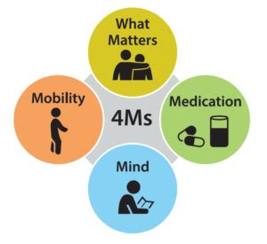
The 4Ms Framework
Provides a common language and approach to care planning with older adults
Evidence-based
Components are inter-linked
Applies across settings
Ambulatory/clinic, urgent care, hospital, long-term care, post-acute care
Applies to healthcare providers, patients, caregivers
Applies to managing disease states (e.g., diabetes, chronic kidney disease)
What about other stakeholders?
4Ms as a holistic approach to address the needs of older adults
Promote aging in place

Slide 6
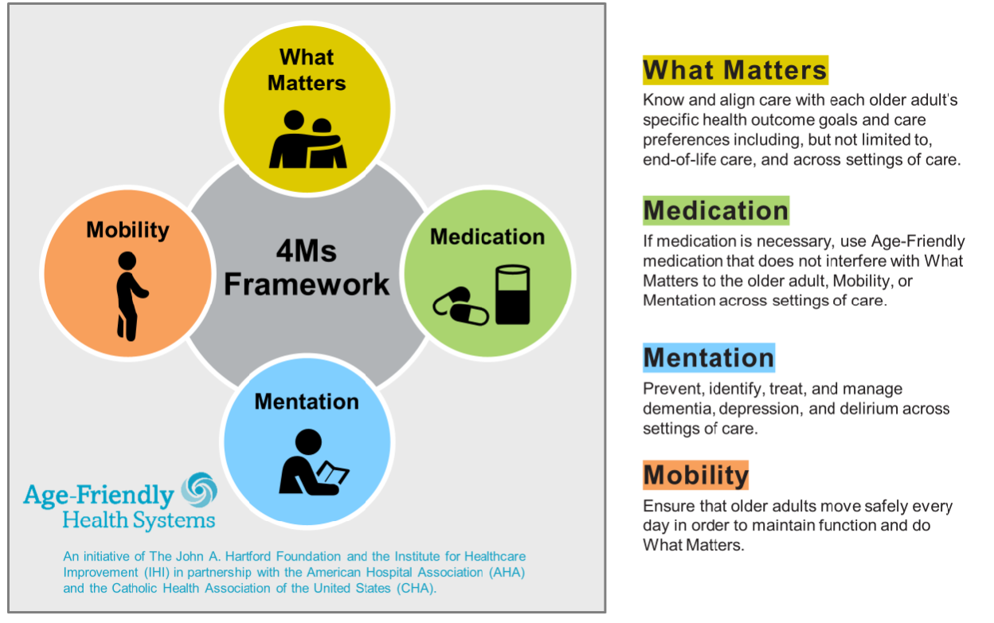

Slide 7
What Matters (aka Matters Most)
Know and align care with patient’s health outcome goals and care preferences
Prioritize patient-specific goals
Avoid unwanted care
Collaborative goal-setting improves health outcomes
Engage patients & caregivers in care planning conversations
Clinicians AND patients / caregivers weigh benefits & harms of therapy options
Balance clinical practice guidelines with patient preferences
Directly talk with older adult about what Matters Most
Start with Advanced Directives, healthcare power of attorney

Slide 8
Medications
Use “age-friendly” medications: ensure mobility, mentation, and what matters are not negatively impacted
Review ALL medicines for proper dosage, duration of use
Prescription, over-the-counter, and dietary supplements
Avoid high-risk medications (that impact mobility, mentation)
Benzodiazepines for sleep or anxiety (alprazolam, diazepam, lorazepam, others…)
Sedatives and sleep medications (such as zolpidem or eszopiclone…AND OTC products)
Antidepressants, tricyclic (such amitriptyline, nortriptyline…)
Antipsychotic agents when used for behavioral symptom in patients with dementia
Opioids (such as oxycodone, morphine, hydrocodone, others…)
Muscle relaxants (such as carisoprodol, methocarbamol, others…)
“Anticholinergic drugs” (drugs with common side effects; used for a variety of reasons)

Slide 9
Medications (continued)
Reduce or stop (taper) medicines that are harmful or no longer needed
Deprescribing = systematic process of reducing doses or stopping unnecessary or harmful meds.
Educate patient and caregiver re: medication management
Especially when transitioning to home
Help promote safe medication use at home:
Simplify the person’s medication regimen
Address barriers such as cost, vision, hearing, dexterity, cognitive function, health literacy, etc.
Resources: AGS Beers Criteria; Deprescribing.org; Health in Aging website

Slide 10
Mentation (“Mood & Memory”)
Prevent, identify, manage depression, dementia, delirium
Annually screen for depression, dementia (& mild cognitive impairment); prevent delirium (during hospitalizations)
Ensure hearing & vision aids available; minimize social isolation
Hydration, sleep, avoid high-risk medications
Emphasize modifiable risk factors for dementia; e.g., “Life’s Essential 8TM” (American Heart Association)
Refer for support, patient & caregiver education
Resources: Self-Administered Gerocognitive Exam (SAGE); Life’s Essential 8TM
Control blood pressure | Control cholesterol | Control diabetes | Physical activity
Smoking cessation | Ensure sufficient sleep | Weight loss / healthy weight | Mediterranean diet, DASH diet, or combo (MIND diet)

Slide 11
Mobility
Ensure patient can move safely to maintain function and do what matters
Maximize activity; set daily goals
Ambulate daily (e.g., 3x/day in hospital)
Train caregivers on how to assist (especially when transitioning to home)
Address pain, strength, balance, & high-risk medications
Refer to physical or occupational therapy
Educate patient & caregivers
Screening tools: Activities of Daily Living (ADLs), Instrumental Activities of Daily Living (IADLs)

Slide 12
Interconnected Nature of the 4Ms
What Matters
Medications
Mentation
Mobility
4Ms

Slide 13
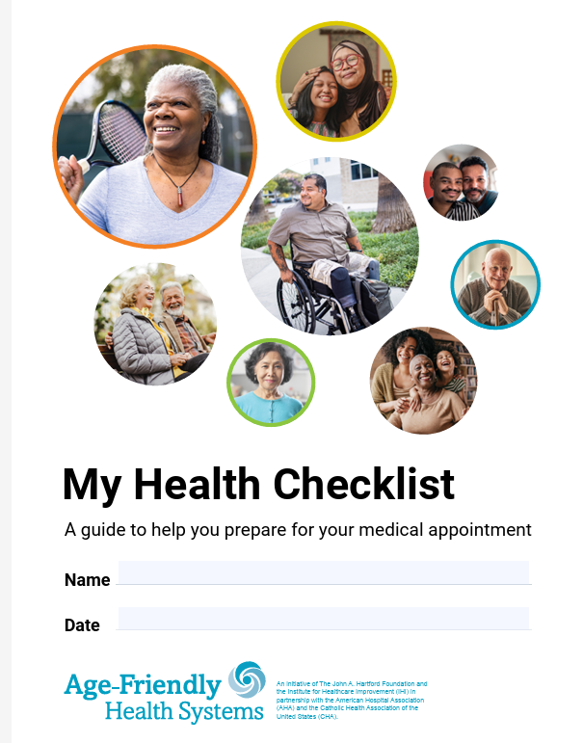
Empower your clients with the 4Ms Framework
My Health Checklist
Tool to help clients prepare for health care encounters
Plan for each encounter using the 4Ms framework
Available online at Institute for Healthcare Improvement website
https://www.ihi.org/my-health-checklist
English, Chinese, Portuguese, Spanish

Slide 14
My Health Checklist
Focus on What Matters to the individual
What are most important things in the person’s life right now?
People, situations, upcoming events, feelings/emotions
What is going well? What activities do you enjoy?
What could be better? What gets in the way?
Identify information provider should know about
Responsibilities, network of support or lack thereof, e.g.
Medications
Current medications (include all 3 categories of drugs!)
What is going well with the medications
What could be better (side effects, medication management, affordability, e.g.)
What questions or concerns for provider

Slide 15
My Health Checklist
Mentation (“mood & memory”)
What is situation now:
How happy? How worried about memory? Changes or comments about mood or memory?
What’s going well
What could be better
Questions or concerns for provider
Mobility (how the person moves & gets around)
What is your situation now?
What’s going well?
Ability to _______ [walk dog, exercise, grocery shop…]; pain level improved, e.g.
What could be better?
Any limitations, concerns
Questions or concerns for provider

Slide 16
Next Steps—preparing for clinic appointment
Review all answers
Prioritize top 3 questions or concerns for provider
Talk it over; answers can change over time
At your next appointment, start the conversation with the provider:
“I have a couple of things that are really important to me. Can we talk about them?”

Slide 17
Applying the 4Ms
NB is a 72-year-old female with health complaints of “poor memory” and back pain
She lives with her husband in their own home.
One adult child lives nearby
Consider: how would our conversation be different if client lived in Assisted Living or Long-term Care?
Medication list:
Donepezil 10 mg daily (memory)
Gabapentin 300 mg 3 times a day (pain)
Methocarbamol 500 mg every 8 hours (pain) (muscle relaxant)
Acetaminophen, 1000 mg 4 times a day (pain)
Rosuvastatin 10 mg daily (cholesterol)
Sertraline 50 mg daily (depression)
Synthroid® 0.075 mg daily (lo thyroid)
Claritin® 10 mg once daily (allergies)
Zolpidem 10 mg at bedtime (sleep)
Tylenol® PM, 2 tablets at bedtime (sleep and anticholinergic drug)
Supplements: Vitamin D3, Vitamin C

Slide 18
What Matters: identifying patient’s preferences and goals
Patient goals & expectations
What does she enjoy?
Barriers?
What is most important for her health?
What are most important things in her life now?
Any recent health changes?
Any recent life changes?
What questions might you ask from the perspective of the service you provide?

Slide 19
Medications: ensuring age-friendly medications
What medications does she take regularly?
What meds only as needed? (and how often?)
Are medications helping you [reach your goals]?
Include prescription, OTC, and supplements!
Have list evaluated for non-”age-friendly” medications
Are there alternatives?
Non-drug options?
Barriers to What Matters
Adherence? Able to follow instructions?
Access? Affordability?
Any medications that affect memory/cognition?
Pain management medications? Alternative options?
Husband able to support her?
Side effects, cost, complex schedule
What concerns do you have about your medications?
Medication management concerns
What questions might you ask from the perspective of the service you provide?

Slide 20
Mentation: Addressing Depression, Dementia, Delirium
Dementia – what stage?
How does it impact her mobility? Ability to take medications?
Are medications negatively impacting cognitive function?
Depression
Referral for talk therapy?
Modifiable Factors
Social engagement
Hearing
Adequately managed?
Need to adjust drug therapy?
Sleep
Nutrition & physical activity, etc.
What questions might you ask from the perspective of the service you provide?

Slide 21
Mobility: Ensuring Safe Movement
Can she safely move to do what Matter Most to her?
ADL and IADL assessment, Timed Up and Go
What activities does she enjoy doing?
Ways to maximize, improve mobility
PT or OT needed?
Strength or balance exercises?
Medications and Mobility
How can we improve pain control?
Assistive device(s) needed?
Current activity? Motivation/interest?
What questions might you ask from the perspective of the service you provide?

Slide 22
Next Steps… Collaboration
Discuss with other care providers, client & family…
Align your care with What Matters (or Matters Most) to the client
Prioritize recommendations
Develop plan as it applies to your service
What might collaboration look like?

Slide 23
Advocate for Age-friendly Care
Collaborate across settings
Ensure the health care, financial, and residential needs of client are considered
Align efforts with what Matters Most to the client
Encourage adoption across various services (e.g., insurance & financial, home aid, placement) & continuum of where older adults receive care
Advocate for comprehensive coverage options that include mental health support, mobility aids, physical therapy, occupational therapy, nutrition services, etc. – to address clients’ health conditions
Support appropriate training of care providers (informal & formal)
Matters Most, Medications, Mentation, & Mobility are interconnected

Slide 24
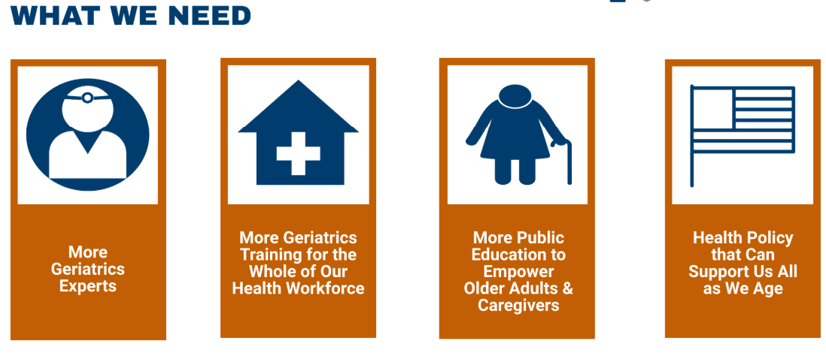
Advocate for Age-friendly Care
Advocate for adoption of Age-friendly Health Systems initiative and 4Ms framework in all health care settings
We can help amplify the urgency to improve care of older adults
Image form the American Geriatrics Society: https://www.americangeriatrics.org/geriatrics-profession/about-geriatrics/geriatrics-workforce-numbers

Slide 25
Grow the Age-friendly Care Movement
Entities can become recognized as an Age-friendly Health System
Home health newly added as a site, e.g.
https://www.ihi.org/age-friendly-health-systems-recognition
American Society of Consultant Pharmacists (ASCP) has developed an Age-friendly Pharmacist digital badge

Slide 26
Resources
Age-friendly Health Systems Initiative: https://www.ihi.org/networks/initiatives/age-friendly-health-systems
https://www .ihi.org/age-friendly-health-systems-resources-and-news
AGS Beers Criteria®: https://www.healthinaging.org/medications-older-adults/medications-older-adults-should-avoid
Health In Aging: https://www.healthinaging.org/ (American Geriatrics Society’s Foundation)
Deprescribing.org (patient-oriented resources about reducing or stopping harmful or unnecessary medications): https://deprescribing.org/resources/deprescribing-information-pamphlets/
Self-Administered Gerocognitive Exam (SAGE): https://wexnermedical.osu.edu/brain-spine-neuro/memory-disorders/sage
Life’s Essential 8TM : https://www.heart.org/en/healthy-living/healthy-lifestyle/lifes-essential-8
Activities of Daily Living (ADLs) and Instrumental Activities of Daily Living (IADLs): https://www.medicaidplanningassistance.org/activities-of-daily-living/
TUG test, STEADI Older Adult Fall Prevention: https://www.cdc.gov/steadi/index.html

Slide 27
Take-home Points
Goal of Age-friendly Health Systems is to improve health outcomes, quality of life, and satisfaction of older individuals
Needed now
Evidence-based
This initiative starts with but is not limited to healthcare facilities
How can you incorporate the 4Ms framework–and mindset–into your workflow?
My Health Checklist is a tool to help bring the 4Ms framework to older adults and their families
Help advocate for greater awareness
Patients, caregivers, colleagues
Encourage adoption by healthcare providers
Encourage adoption by others who provide services to older adults

Slide 28

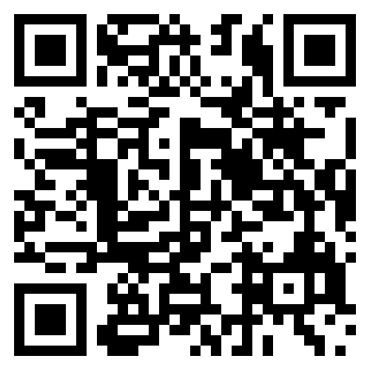
Thank you! Time for Your Questions
Hedva Barenholtz Levy PharmD, BCPS, BCGP
Hedva@hblpharm.com
www.hblpharm.com (business)
www.BarenholtzLevy.com (author)
Connect with me on LinkedIn
And X (@HedvaPharmD)
Join my monthly newsletter

