Slide 1
So, I’ve Got This Wild Idea…
Now What??

Slide 3
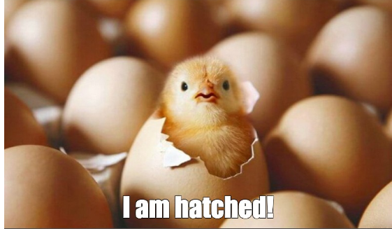

Slide 5
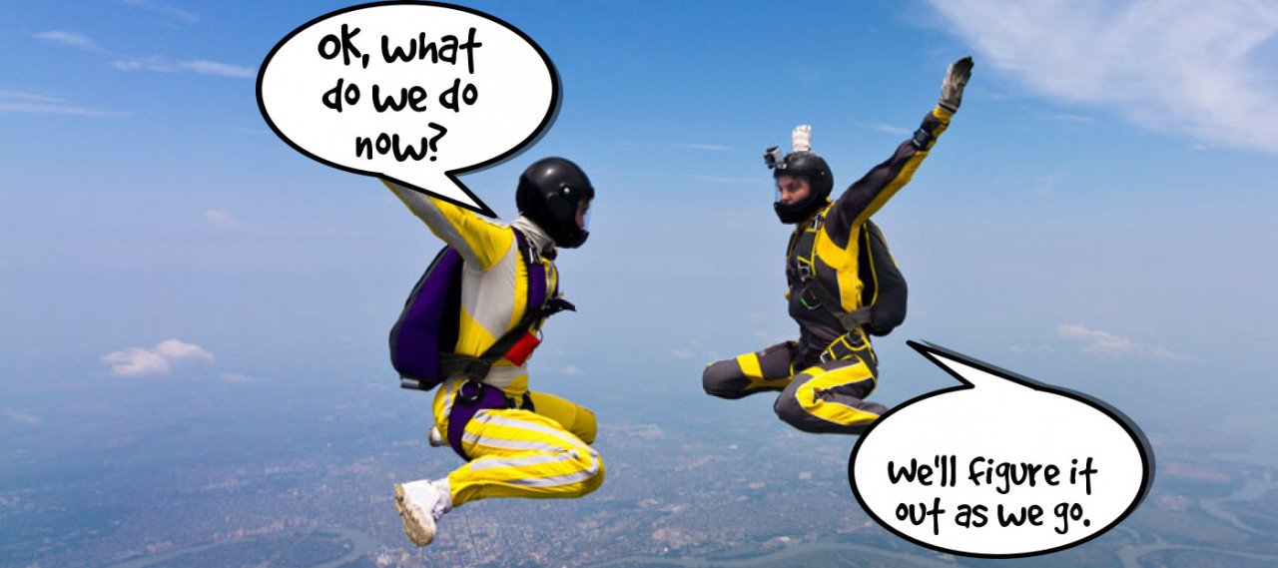

Slide 6
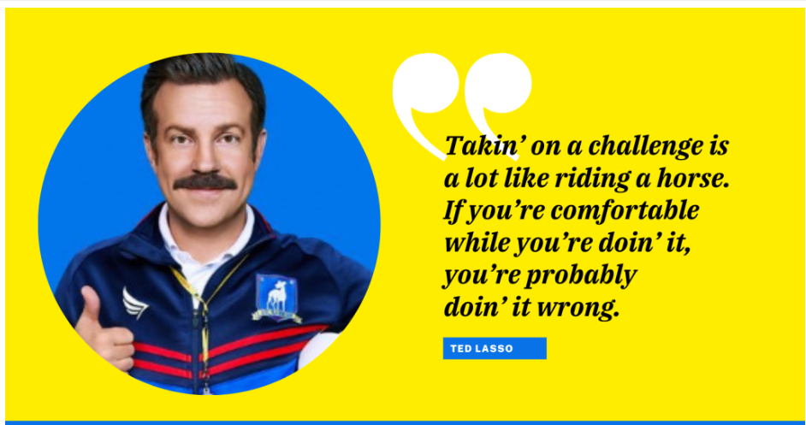

Slide 7
Our story…and yours
Focus on external partnerships
Internal support is a big bonus
These can affect each other
Each endeavor is unique with distinct challenges and opportunities

Slide 8
“No matter what the issue is, the process moving forward is always the same: Find the partners, build the coalition, get the thing done.”
Gretchen Whitmer , Governor of Michigan

Slide 9
“It is the long history of humankind (and animal kind, too) those who learned to collaborate and improvise most effectively have prevailed.”
Charles Darwin

Slide 10
Can we just get a checklist??

Slide 11
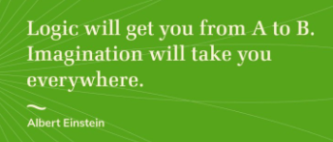

Slide 14
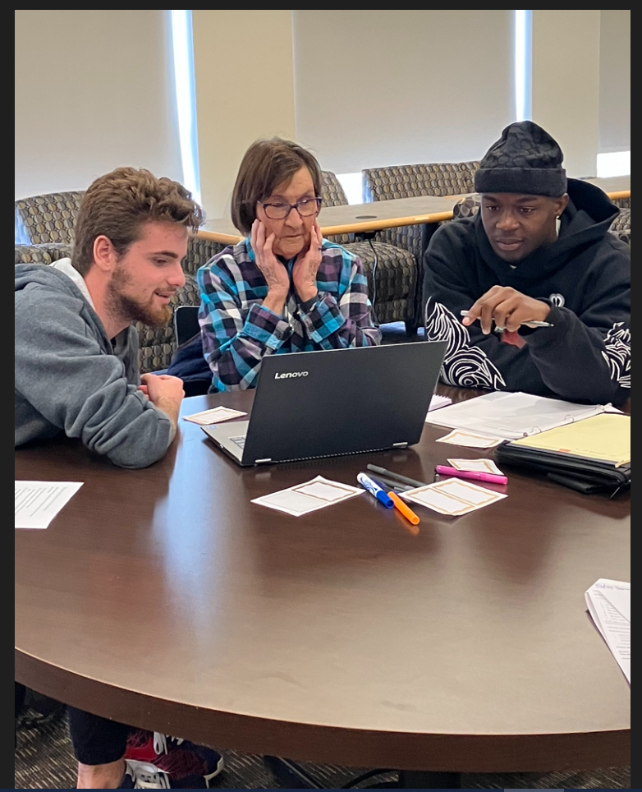
We truly are a perfect match! We compliment each other’s existing programs and when combined, it’s really a magical experience for our participants. Annie Alameda, PhD Professor and Director of LindenWELL

Slide 15
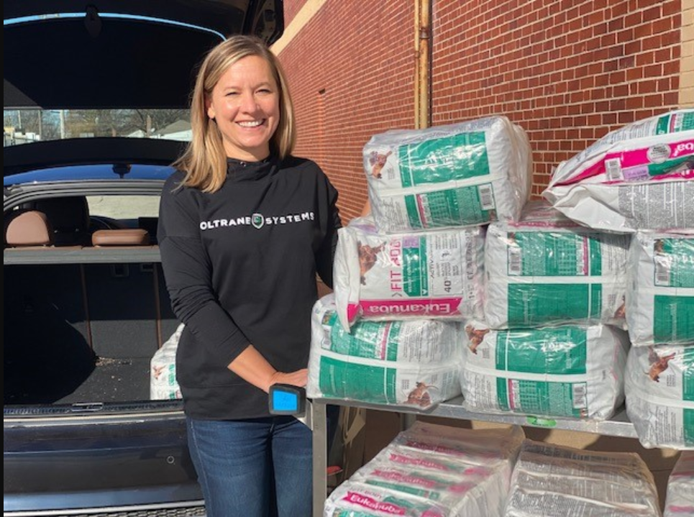
“Our senior neighbors can be vulnerable if there’s no one there to check on them. Volunteering with Aging Ahead is just one way to do that.” Todd Gibson, Director Field Operations for eastern missouri

Slide 16
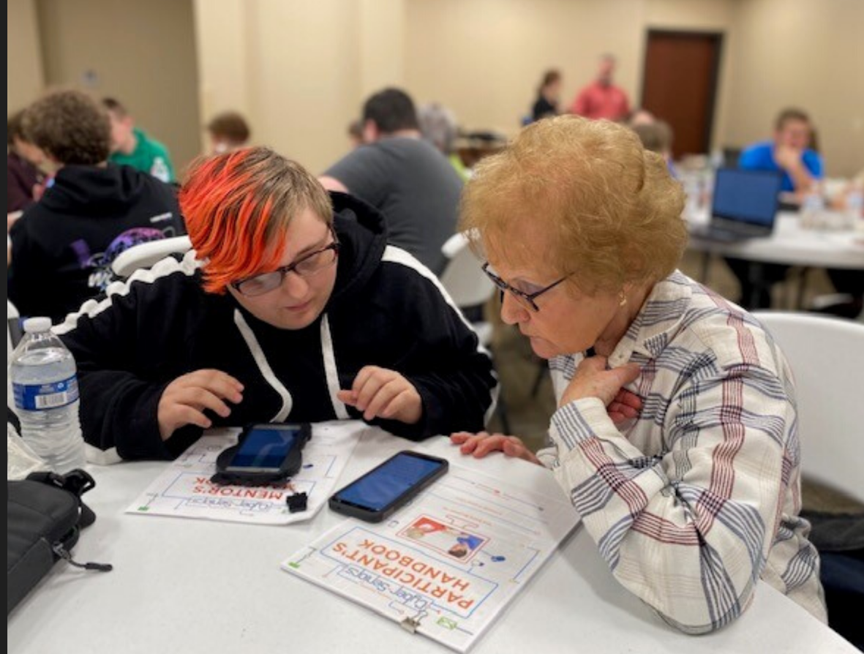
We want our relationship with Aging Ahead to be a true partnership. We’re not going to just be takers. Maggie Melson, Director of adult and youth services

Slide 17
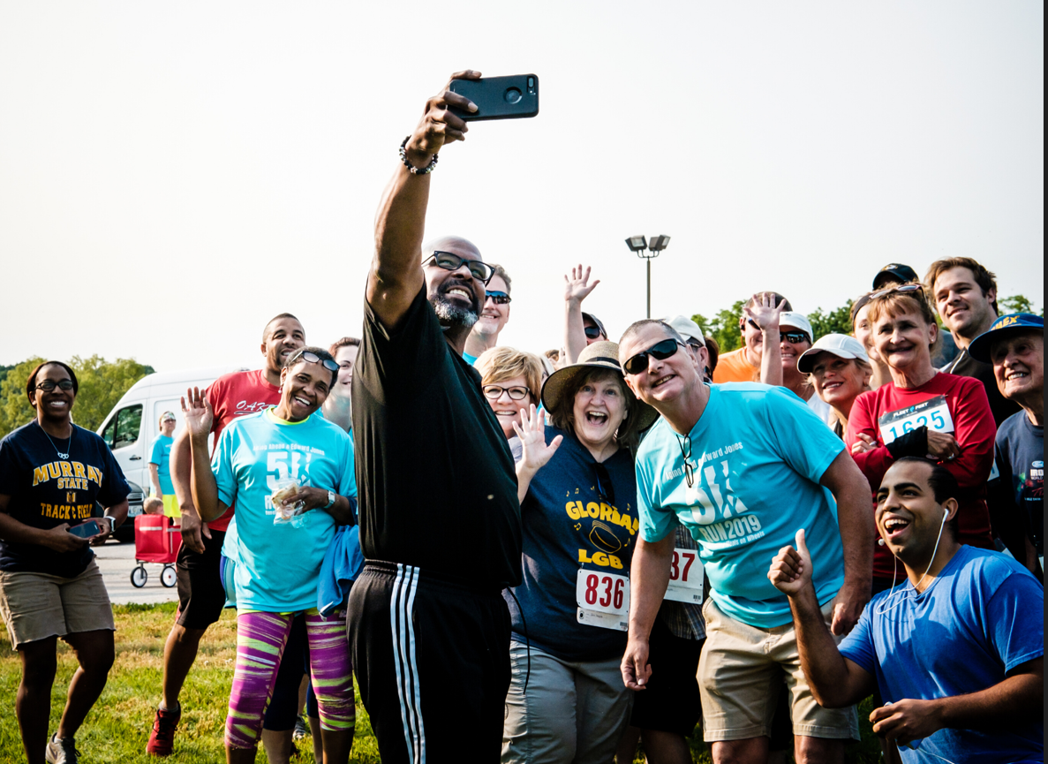
I HOPE WHAT OUR TEAM DOES CLEARLY DEMONSTRATES OUR COMMITMENT IN SUPPORTING YOUR CAUSE AND OUR SENIORS WITHIN THE COMMUNITIES WE BOTH SERVE.
MARCEL NADDAF, REGIONAL HEALTHCARE DIRECTOR

Slide 20
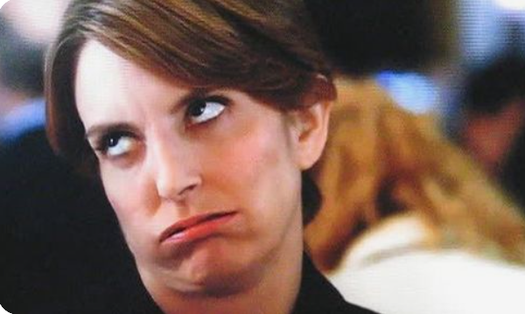

Slide 22
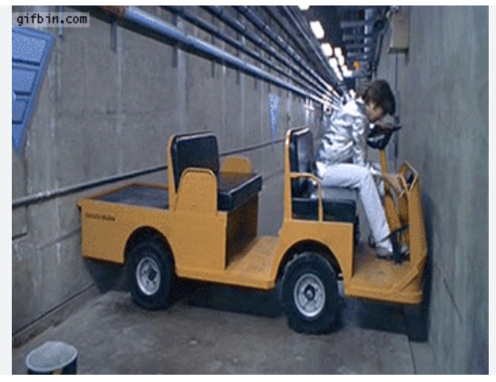

Slide 23
They’re not quite there yet…
INSPIRE!
Listen to their story
Solve their problem
Identify the common ground
Codevelop the solution
Stay high level
Continue meeting!

Slide 24
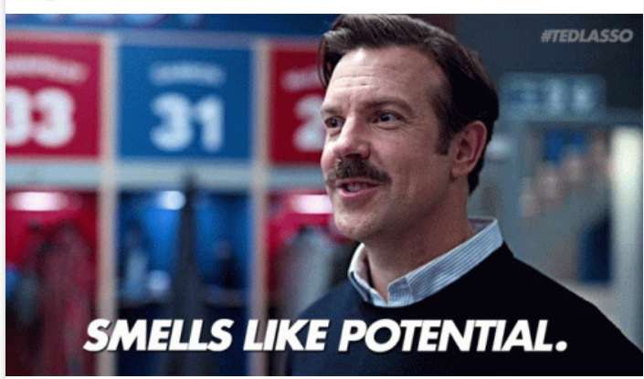

Slide 25
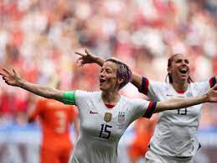
Find your Champion!

Slide 27
.
What’s Your Wild Idea?

