Slide 1
Hear Is Why Our Brain Matters
Kate Sinks, Au.D., ABAC, CCC-A, F-AAA
Jackie Dover BS in Public Relations & Marketing
Liz Yokley, MPA, BSW

Slide 2
Disclosures
Kate Sinks:
Employed as Director of Audiology at the Center for Hearing & Speech
No relevant non financial relationships
Jackie Dover/Liz Yokley:
Employed with Aging Matters the Southeast Area Agency on Aging
Experience working with the Senior population for 25+ years
Do not collect client information for distribution or charge for services rendered

Slide 3
Center for Hearing & Speech
Notes:
The Center’s Mission is to Transform lives by empowering communication. This is supported by our core values of Personalized care, leading from a place of practice,
reaching beyond our services, and advocating for communication as a human right. We’ve been fortunate to do so for over 100 years.
In 2022 we served a total of 13226 clients with 9 clinicians. Annually our development revenue ($ raised) is just over $1 million or 41% of our operating budget.
We have 5 programs and three locations to serve: Rock Hill, St. Louis City, and Festus. CI Services are primarily conducted at Rock Hill and Festus
Audiology: Diagnostic hearing evaluations, hearing aids, cochlear implants, assistive listening devices, hearing protection
Speech-Language: In school and teletherapy. Evaluations, individual therapy, group therapy, & classroom enrichment.
School Screening: Hearing and Vision screenings for city and county schools
Hearing Conversation: On-site testing conducted by certified occupational audiometric technicians, facility noise monitoring assessments, oversite provided by Dr. McKenna Bellamy
Senior Connections: A program dedicated to reducing the social isolation of St. Louis county and city seniors including provision of technology platforms, hearing aids, hearing evaluations, and connection with social worker.

Slide 4
Mission
Aging Matters is the Southeast Missouri Area Agency on Aging which is a not-for-profit organization serving the eighteen counties in Southeast Missouri. Our goal is to provide quality services and information to enhance the health, safety, and well-being of persons, age 60 and over, enabling them to live in their own homes for as long and independently, as possible.

Slide 5
Hearing 101

Slide 6
Notes:
Hearing 101

Slide 7
Prevalence of Hearing Loss
3 in 10 people over age 60 have a reduction in their hearing
1 in 6 baby boomers have hearing problems
1 in 14 Generation Xers (ages 38-58) already have reduction in their hearing
At least 1.4 million children (18 or younger) have hearing problems

Slide 8
Social Symptoms of Hearing Loss
Require frequent repetition.
Have difficulty following conversations involving more than 2 people.
Think that other people sound muffled or like they're mumbling.
Have difficulty hearing in noisy situations, like conferences, restaurants, malls, or crowded meeting rooms.
Have trouble hearing children and women.
Have your TV or radio turned up to a high volume.
Answer or respond inappropriately in conversations.
Have ringing in your ears.
Read lips or more intently watch people's faces when they speak with you.
Withdraw from activities you used to enjoy

Slide 9
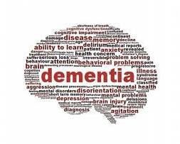
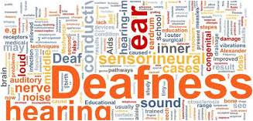
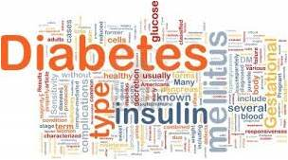
Hearing Loss and Comorbidities
Notes:
Heart and Cardiovascular Disease: A growing body of research shows that a person’s hearing and cardiovascular health frequently correspond. It’s a good idea for people with cardiovascular disease to get their hearing checked, and for people with hearing loss to pay close attention to their cardiovascular health.
Diabetes: Hearing loss is about twice as common in adults with diabetes. If you have diabetes, be sure to get your hearing checked as part of your routine care.
Cognitive function, dementia, and Alzheimer’s disease: Studies show that older people with hearing loss are more likely to develop dementia over time than those who retain their hearing. Research also shows that hearing loss among older adults appears to be associated with a faster rate of cognitive decline than in people without hearing loss. So what’s the take away? Get your hearing tested and address any hearing loss.
Depression and Anxiety: Research shows that hearing loss frequently co-exists with depression and/or anxiety. In fact, people with untreated hearing loss may be at an increased risk of depression. When left unaddressed, hearing loss can lead to isolation and other emotional conditions that can affect both qualify of life and mental health. But we also know that by treating hearing loss, the risk of associated depression and other mental health issues lessens significantly. So go ahead. Be happy. Get your hearing tested.
Chronic kidney disease: Some research has shown that people with moderate chronic kidney disease have a higher prevalence of hearing loss than those without the disease. While we await more research in this area, it may make sense for people with chronic kidney disease to have their hearing checked as part of their routine care.

Slide 10
Consequences of Untreated Hearing Loss
Irritability, negativism and anger
Fatigue, tension, stress and depression
Avoidance or withdrawal from social situations
Social rejection and loneliness
Reduced alertness and increased risk to personal safety
Impaired memory and ability to learn new tasks
Reduced job performance and earning power
Diminished psychological and overall health

Slide 11
Hearing and Cognition

Slide 12
Understanding Spoken Language
Understanding spoken language requires more processing than perceiving the sound
Signal degradation in the environment
Background noise/competing talkers
Unclear stimuli
Lexical effects
Signal degradation in the listener
Severity/configuration of hearing loss
Cognitive Disorders
Auditory processing ability
Notes:
Auditory processing and its relationship to cognition can be quite complex and requires years of study to fully understand. Today I’d like to give you some high level information that you can use when working with clients, caregivers, family, and neighbors.
We as audiologists aim to improve the ability to understand spoken language, and yet doing so requires more than measuring your ability to hear. To do so we can consider how the intended speech signal can become degraded both in the environment and within the listener.

Slide 13
Background Noise
Background noise causes the ears of those with hearing loss to work differently
When immersed in the nois, the neurons of the inner ear must work harder because they are spread too thin
There is essentially no change, even for those with hearing loss, in terms of how the cochlear neurons are processing tones in quiet surroundings, but once noise is added, a diminished coding of the temporal structure occurs
The auditory system of the inner ear filters sound into a number of channels that are tuned to different frequencies, and those channels vary based on their frequency tuning.
Notes:
Spread too thin: It’s comparable to turning on a dozen television screens and asking someone to focus on one program. The results can be fuzzy because these neurons get distracted by other information
Frequency tuning: In a normal system the channels are sharp and focused, but they get broader and more scattered with hearing impairment.

Slide 14
Unclear Stimuli
When listeners hear speech they must match the rapid incoming acoustic stream to stored representations of words and phonemes (speech sounds) to successfully extract the intended meaning.
The process of correctly identifying sounds is made more difficult when speech is acoustically degraded: less information is available to the listener, which reduces the quality of speech cues and thus increasing the chance for error
Notes:
In previous studies of spoken language researchers have experimented with acoustic clarity of speech and discovered that brain activities vary depending on how unclear the stimuli are

Slide 15
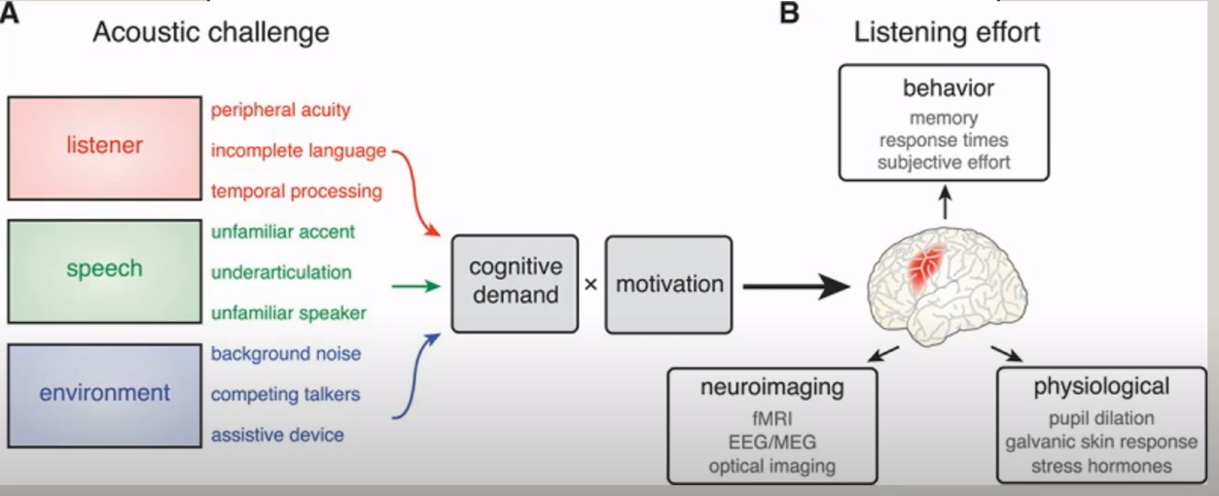
Notes:
The acoustic challenge associated with any stimulus depends on the ability of the listener, the clarity of external signal, and acoustic environment. The overall AC experienced by a listener is affected by their individual hearing ability and external characteristics such as the speech quality of the talker and background noise.
AC increases cognitive demand which is a key contributor of listening effort and this is moderated by the listeners motivation. When speech is not easily match to a listener's expectations additional neural processing is required. Increases in listening effort can be measured under functional brain imaging. They are reflected in the physiological responses outside the brain and they frequently result in behavioral differences.

Slide 16
Lexical Effects
In the context of lexical competition. Words with a large number of competing targets such as Cat, Cap, Cab or words that are less dense (rarely used in speech) are more difficulty to be perceived
Additionally, context can affect a hearing impaired person’s ability to understand speech
If you’ve been having a conversation about a baseball game and all of the discussion is related to baseball, you’re likely going to be able to fill in the blanks
However, if you’ve been discussing baseball and someone begins discussing what they had for dinner last night, you will have a more difficult time filling in the blanks because the conversation is now lacking context

Slide 17
Signal Degradation in the Listener

Slide 18
Severity and Configuration of Hearing Loss
More wizened people with moderate to severe hearing impairment had a 29-57% greater risk of cognitive impairment than those with normal hearing
A recent study, compared to those with normal hearing, individuals with mild to moderate hearing loss had a 24% increased risk of incident cognitive impairment.
Rates of cognitive decline aren the risk of incident cognitive impairment were linearly associated with the severity of an individual’s baseline.

Slide 19
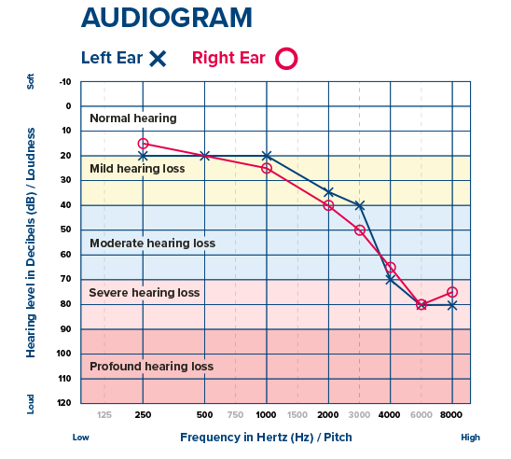
Notes:
Often time in appointments my patients share that they can hear people but don't always understand what is being said. This is directly related to the configuration of their hearing loss.
The majority of people with permanent hearing loss have better LF hearing than HF. Male voice and vowels have a greater emphasis on lower pitch sounds. Children, women, and consonant sounds have a greater emphasis on higher pitch sounds. Consonants give us CLARITY of speech

Slide 20
Age
The normal aging process is associated with declines in certain cognitive abilities, such as processing speech, auditory memory, language, visuospatial, and executive function abilities.
As a person ages, his or her brain faces significant changes.
There is significant variability in age-related cognitive changes from individual to individual. Some of that variability can be attributed to genetic differences, and studies estimate 60% of general cognitive ability can be attributed to genetics. Medical illness, psychological factors, and sensory deficits such as vision and hearing impairment certainly can also accelerate age-related cognitive decline
Participation in certain activities, building cognitive reserve, and engaging in cognitive retraining may all be approaches to achieving successful cognitive aging
Notes:
The brain must compensate for the lack of auditory input and these compensations are much more difficult for older listeners.
Significant changes: One study found that as older adults listen to spoken sentences, their brains use many of the same regions as younger adults. However, old adults and individuals with hearing loss have been shown to have greater activation in the frontal lobe of their brain unlike young adults. This may be a sign of increased listening effort that is needed to fully comprehend spoken language.

Slide 21
CORRELATION ≠ CAUSATION
Notes:
There is no definitive proof that HL causes Dementia or Cognitive Decline. There are however many studies that show link between untreated HL and cognitive decline.
Correlation is simply a statistical technique which tells us how strongly the pair of variables are linearly related and change together. It does not tell us why and how behind the relationship, but it just say the relationship exists.
Causation takes a step further than correlation. It says any change in the value of one variable will cause a change in the value of another variable (CAUSE AND EFFECT)

Slide 22
How We Can Help

Slide 23
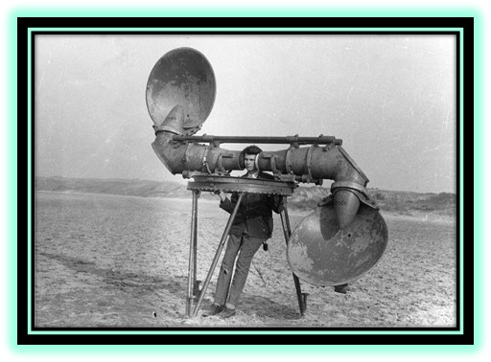
Notes:
Is this what you think of when it comes to hearing aids? We’ve come a long way!

Slide 24
Aging Matters
A man realized he needed to purchase a hearing aid, but didn't want to spend a lot of money.
“How much do they cost?" he asked.
"They range from $2 to $2,000."
"Can I see the $2 model?" said the customer.
The salesman put a large device around the man's neck, and said: "You just stick this red tube in your ear and run this cable down into your pocket."
"How does it work?" asked the customer.
"For $2, it doesn't work," said the salesman. "But when people see it on you, they'll talk much slower and louder."
Notes:
You get what you pay for
OTC Hearing Devices vs. working with devices design to the individual person

Slide 25
Mission
Aging Matters goal is to provide quality services and information to enhance the health, safety, and well-being of persons, age 60 and over, enabling them to live in their own homes for as long and independently, as possible.
Notes:
Kate spoke the prevalence of hearing loss. At Aging Matters we agree with everything that she shared with you but how do we address it?
She also spoke about the Social impact and the medical conditions that can affect someone. As stated early Aging Matters Mission statement looks at…..
This relates to hearing due to enhancing the seniors health, safety, and well-being.

Slide 26
Miracle Ear Partnership
How the partnership started
Goal of program
Screening process
Funding
Outcome

Slide 27
How Partnership Started
Need
18 counties
Miracle Ear Foundation
Notes:
Need - Hearing Aids tend to be a service that is not covered and as stated by Kate Sinks it is a vital area to help a person's overall well-being. As our mission statement states we want to enhance the the health, safety, and well-being of persons, age 60 and over, and enable them to live in their own homes independently. We had been talking with individuals about the Miracle Ear Foundation, Starkey foundation - however, they are no longer an option at this time. Some Medicare Advantage plans have some funding to help with hearing devices but you do need to find a provider that takes it or there is still a $ amt. That the person can not afford.
Aging Matters serves 18 counties and wanted to find a location that would provide centralized location throughout the counties served.
They work with a foundation program so had a concept of what Aging Matter was wanting to accomplish.

Slide 28
Goal of Program
Help those with limited income acquire appropriate hearing device.
Prevent Barriers
Notes:
The goal of the program is to help those, with limited income, hear better. Aging Matters has partnered with Miracle Ear to provide hearing devices. To qualify for the program participants must be sixty or older, live within the 18-county service area for Aging Matter, monthly income must be below 300% of Federal Poverty level, and have a hearing need as determined by Miracle Ear.
Prevent Barriers

Slide 29
Screening process
Age 60 or over
Miracle Ear Foundation
Aging Matters funding
Transportation
Live within the 18 county service area
Monthly income 300% FPL or below
Notes:
The procedure will require a person to contact their local Miracle Ear Office and Miracle Ear will complete the screening process to see if someone qualifies for the program. Anyone can refer someone to the program. They look to see if there is a need, Ove the age of 60, 300% below FPL, and live within the service area. Miracle ear can set-up transportation for clients to and from appointment, if needed, through local county transit to help prevent transportation from being barrier. Aging Matters will directly reimburse the local county tranist company.

Slide 30
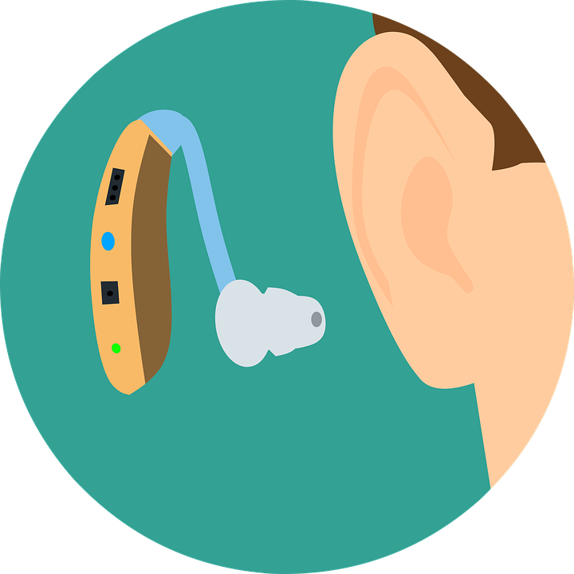
Funding
ARPA Funding
General Funding
Monthly amounts
Notes:
Currently the funding for this program came about due to ARPA funding

Slide 31
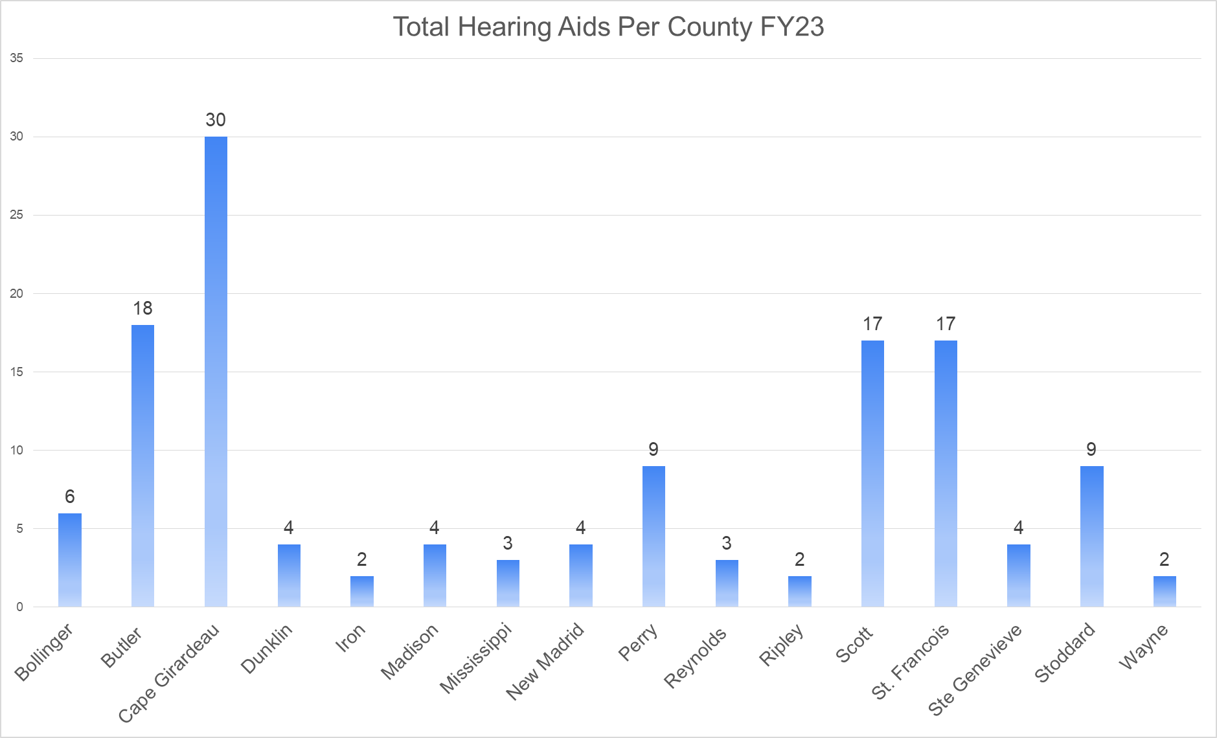
Outcomes

Slide 32
Assisted Programs at
Center For Hearing & Speech
Individuals living in St. Louis City as well as
The Center is proud to offer multiple programs to assist our patients in obtaining hearing and speech services.
Our income dependant sliding scale could cover a percentage or all of the cost.
The Missouri Red Card Assistance (RCA) Program is designed for patients that have a type of Missouri Medicaid that does not include hearing aid or hearing healthcare benefits
Senior Connections: Because of a generous grant from the St. Louis City Senior Fund, a limited number of seniors living in the City of St. Louis may qualify for free hearing aids.
Some patients, who work, want to work, or are in educational programs may be eligible for hearing aid assistance through Missouri Vocational Rehabilitation services.
All these programs run year-round and there are specified periods of open applications.
Based on the usual and customary charges of devices and services we provided $1.47 million in discounts for assisted clients in 2022. We fit 511 devices at discounted rates or no charge.

Slide 33
The Why
“I just wanted to say thank you for providing me hearing aids. They are fantastic and I could not have afforded them otherwise.”
“Thank you very much I appreciate it. I have never received a gift like this before. My heartfelt thanks!”
“I can hear again! And I love my hearing aids. Miracle Ear in Cape was so easy to work with and wow, what follow-up service! Thank you so much for funding this hearing program. Ou have changed countless live! Including mine!”
“I was so surprised when he told me you were gonna pay for my hearing aids. I really appreciate it and can't thank you enough”
“ I just want to say how grateful I am to you folks and Miracle ear! I can hear again! I am just so thankful! You just can’t imagine what a difference it has made in my life. I will soon be 64 years old. I have a lot of health issues and we are raising our grandson and my husband and I are both on social security and that's all we have so money is very tight. There's no way we would ever be able to afford hearing aids. I cried when they told me and all I can say is Thank you, Thank you, Thank you!”
Notes:
I am going to try and add a video from a client (vs. my photo lol)

