Slide 1
Going Beyond Traditional Service Models to Reach Seniors
Presented on 9/12/2023 by:
Rhonda Bramlett, Nutrition Project Director
Tracey Tripp, RDN,
Assistant Nutrition Project Director

Slide 2
Presentation Objectives
Explain operations of 4 non-traditional programs that are providing meals and reducing social isolation among rural seniors.
Attendees will understand the steps to begin and operate 4 different service models of nutrition program meal service and possess program forms for use in program replication.

Slide 3
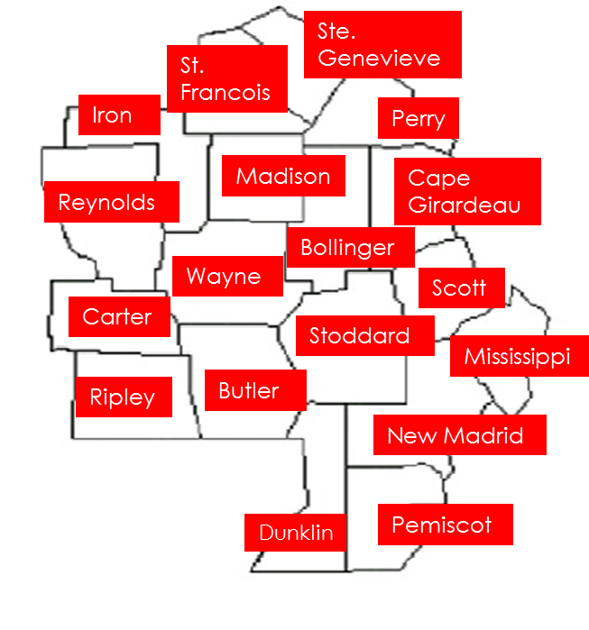

Slide 4
3 Congregate Meal Programs and 1 Home-Delivered Meal Program
Community Hosted Congregate Meal Programs (2)
Matthews, MO (2 days/week) Started June 2022
Senath, MO (1 day/month) Started October 2022
Congregate Meal Voucher Program (1)
Piedmont, MO (2 days/week) Started November 2022
Home-Delivered Frozen Meal Program (1)
Distance Dining Program (Delivery to Rural Clients) Started 2012

Slide 5
Community Hosted Congregate Meal Programs
Must Have:
Community Interest and Buy-In
Commitment of Volunteers
Communication with State Unit on Aging (Missouri DHSS/DSDS Bureau of Senior Programs) to acquire waiver
Funding

Slide 6
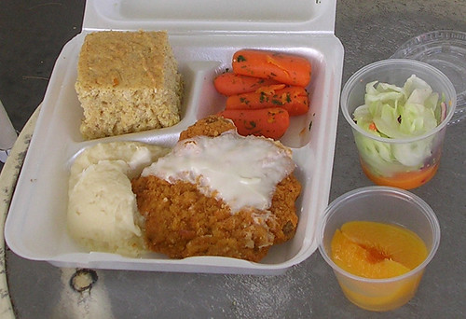
Matthews Senior Meals Program
City of Matthews wanted their own Senior Center
The City had a newly purchased building
The City demonstrated their commitment by purchasing tables and chairs and city clerk helped with registration
They provided volunteers
Regular communication with Administrator of New Madrid Center
Basic Operation:
Client registers with clerk’s office and name placed on printed signature sheet that will be used each day meals are served
People sign up to attend the Tuesday and Thursday meal service
The meal count is given to the Administrator for correct number of meals to be portioned
Volunteers from Matthews come get the meals on Tuesdays and a New Madrid Center staff member brings the meals to Matthews on Thursdays
Client contributions are counted and deposited on Thursdays

Slide 7
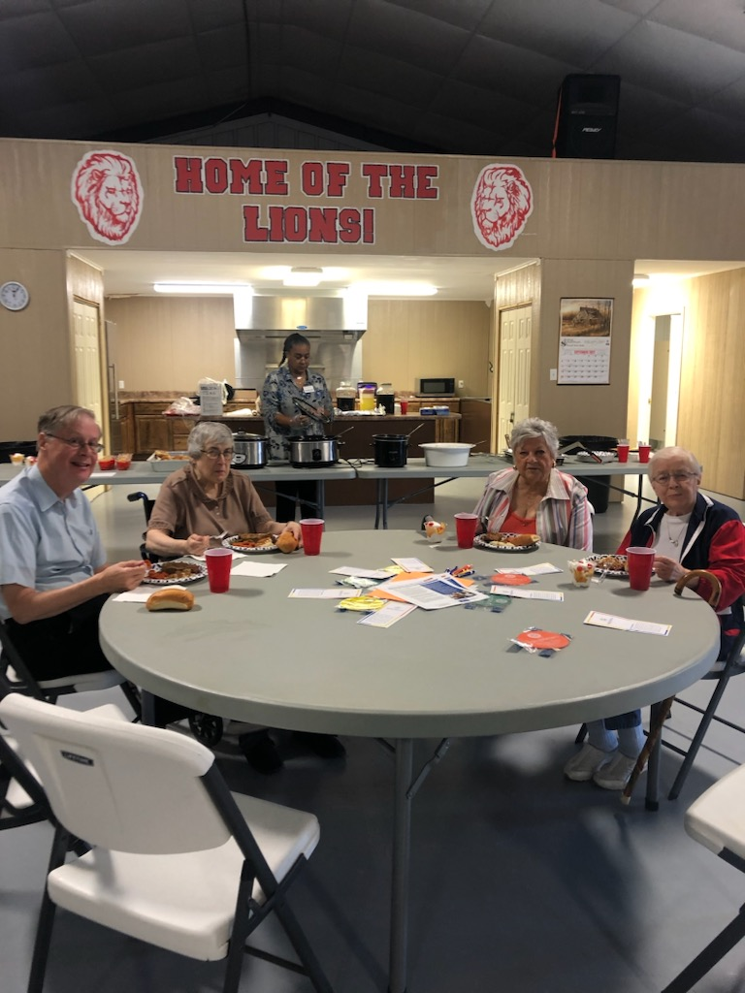
Senath Senior Meals Program

Slide 8
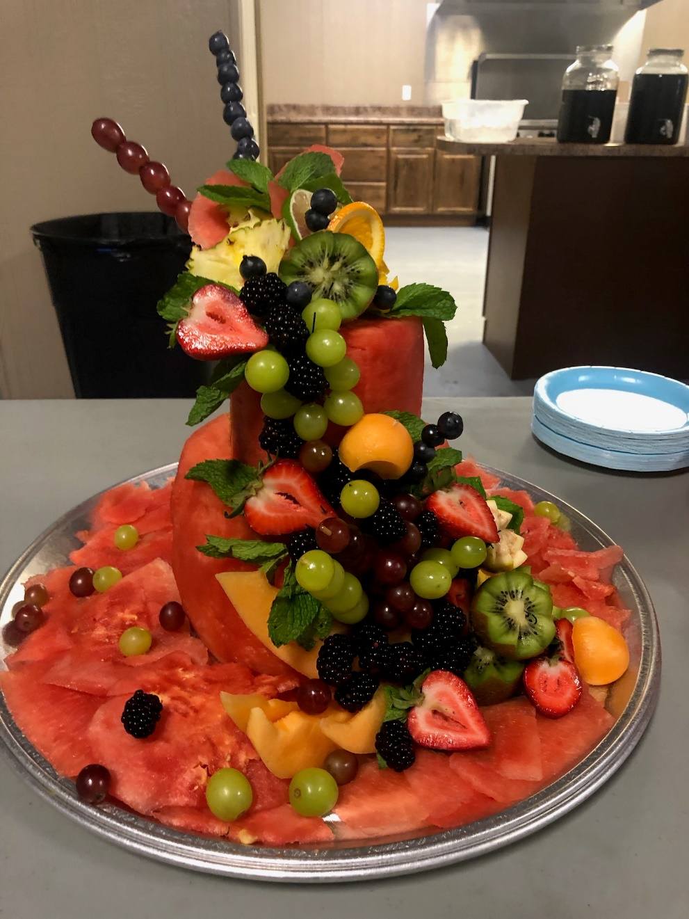
Senath Senior Meals Program
Dunklin County Health Coalition supported the program with outreach, providing volunteers and calling clients
The City of Senath offered their community center as the meal site, free of charge
Senath City Hall was the location for registration
Local Restaurants were contacted to cater the meal
Basic Operation:
Client registers and name placed on printed signature sheet that will be used on the day of meal service
Clients are called to remind them to attend on the 1st Thursday
The meal count is estimated and given to the Restaurant
When clients come in, they sign-in, and then they sit down at a table that has a variety of information for them. (Locked box is there for contributions) Volunteers help serve the meal and clean up.
Client contributions are counted by volunteers and deposited by Aging Matters staff that day

Slide 9
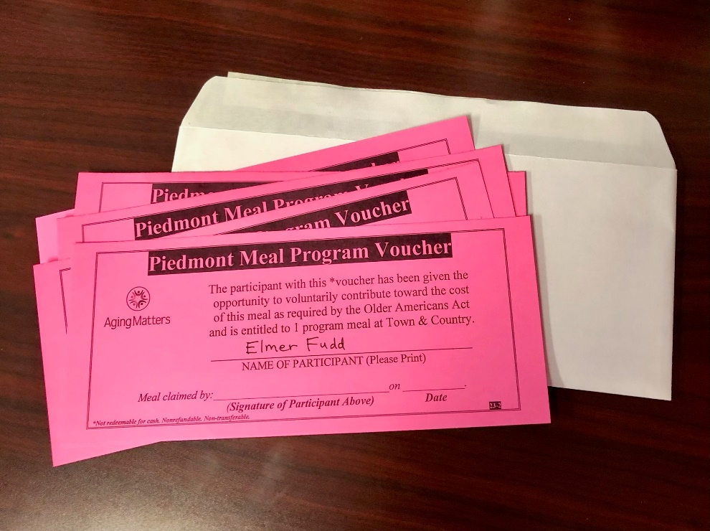
Piedmont Meal Voucher Program
Planning Process
A planning team was established
There were 2 strategy sessions held
An environmental scan was conducted
A waiver was submitted to the State for approval
Created the Voucher process and training given (Wayne Co. Journal Banner)
Menu process was established and training given
Contract was signed with meal provider (Town & Country)
Launched pilot program and will monitor on-site by November 2023
Basic Operation:
Client registers at the Journal Banner office where they are given the opportunity to contribute for the meals and an envelope of 5 vouchers is given to them with their names written on them. The menu/calendar and other beneficial information is in the envelope along with the vouchers.
The Journal Banner makes the deposits of contributions placed in the locked box and sends the documentation to Aging Matters.
Clients take the vouchers to Town & Country to receive the approved Program meal. They must sign and date the voucher at the time they receive their meal.
There is a dining area for clients to gather and socialize/eat the meal that is served from 11:00-2:00 on Mondays and Wednesdays weekly. Carry out meals are not allowed.
The vouchers are then sent to Aging Matters with the bill for the meals Town & Country served.

Slide 10
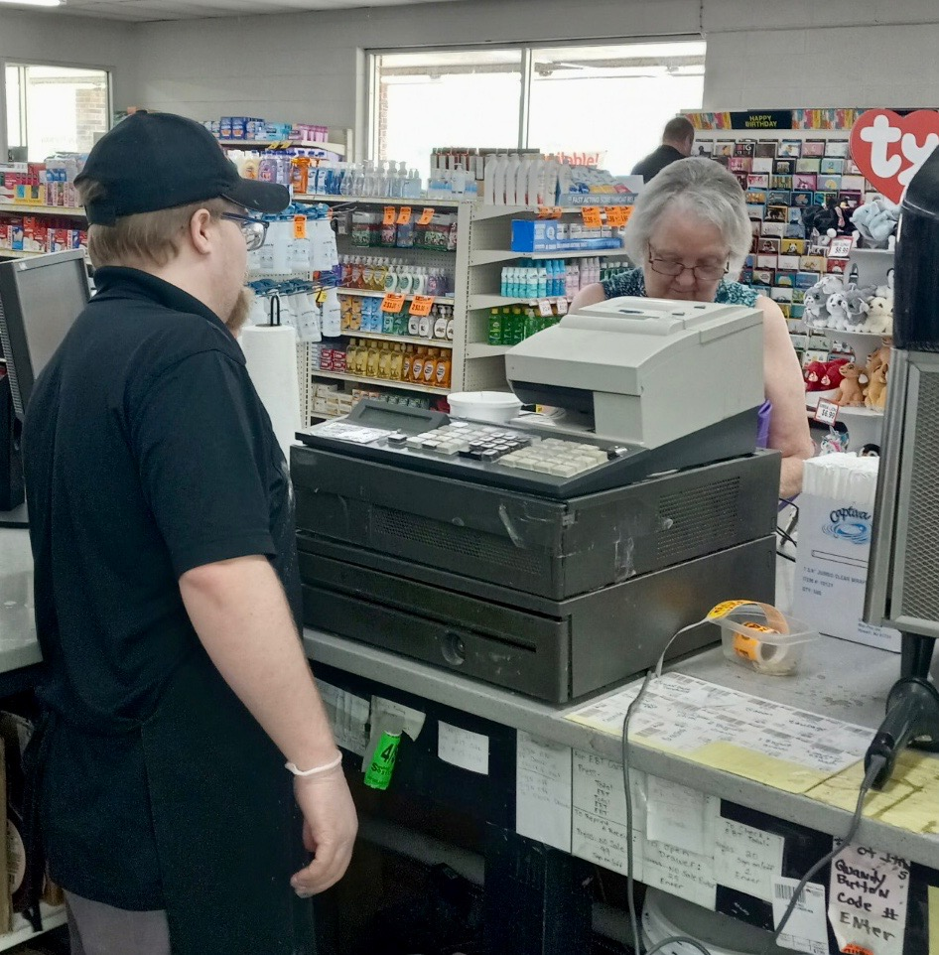
Piedmont Voucher Program

Slide 11
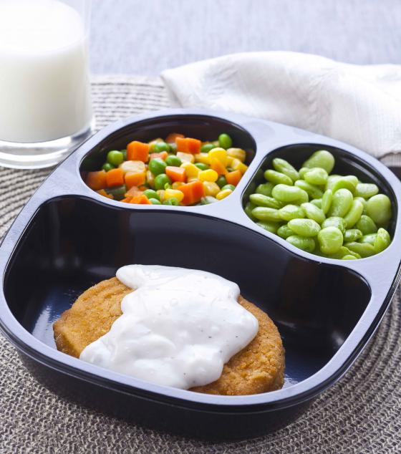
Distance Dining (Frozen) Home-Delivered Meals Program
The Distance Dining Program was designed in 2012 to target the low-income rural persons living outside the delivery area of our 32 senior centers.
Eligibility requirements for the Distance Dining Program are:
· 63 years or older and Medicaid eligible
· Reside in our 18 county rural area, outside delivery area of any senior center
· Must be authorized for Medicaid Meals per their Home and Community Based Services (HCBS) care plan managed by the State of Missouri.
· If the client is currently not receiving HCBS, they will need to contact the call center at 1-866-835-3505 for an assessment to become authorized for home-delivered meals.

Slide 12
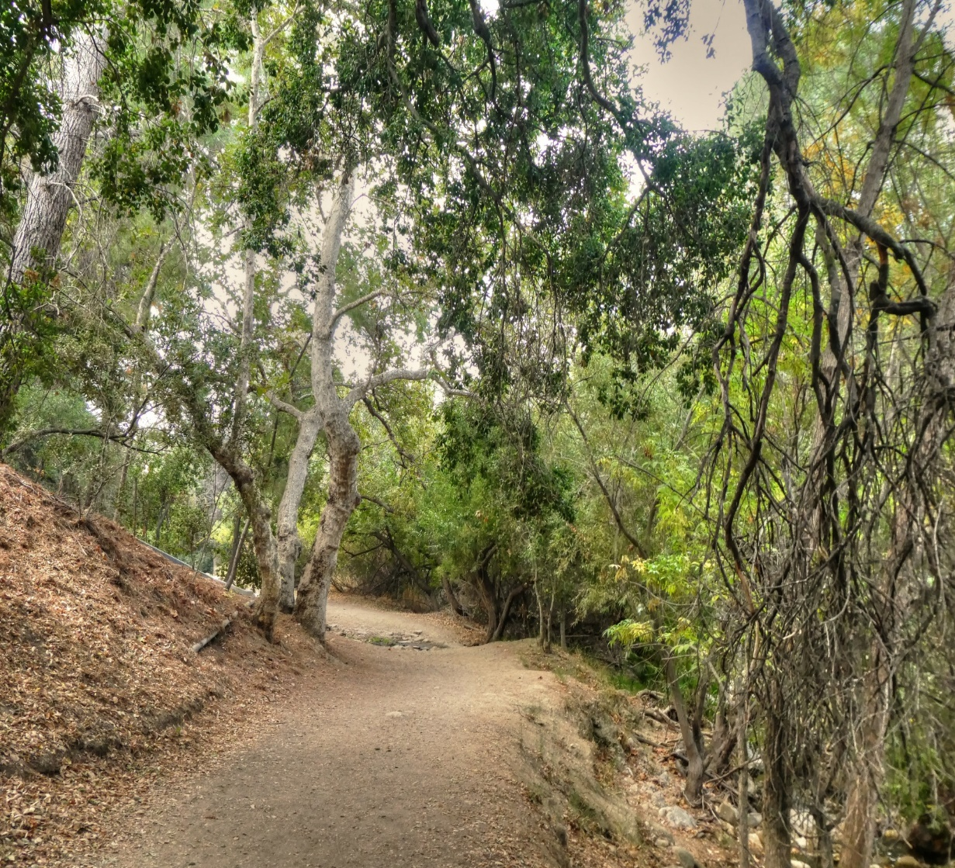
Distance Dining Frozen Home-Delivered Meals Program
Basic Operation:
A client with a newly issued Medicaid meal authorization is declined service by one of our 32 Centers. The client is assigned to the Distance Dining Program. The client is contacted and told about the program by our Distance Dining Coordinator (Cassandra Smith).
The Distance Dining Coordinator, Cassandra, works with our delivery provider (Trio) to establish the meal routes that are delivered every other week.
Trio communicates any issues they have with the client(s) to Cassandra.
Nutrition Education and other beneficial information is sent to clients at least quarterly.
There are challenges to make sure the client address is accurate and to stay in contact with the clients as phone numbers change/cell service is not available at times. Cassandra works with the in-home providers as well, to seek timely information.

Slide 13
Rhonda Bramlett, Nutrition Project Director and
Tracey Tripp, RDN, Assistant Nutrition Project Director
Rhonda@agingmatters2u.com and Tracey@agingmatters2u.com
(573) 335-3331 ext 112 or ext 103
Aging Matters
1078 Wolverine Suite J
Cape Girardeau, MO 63701

