Slide 1
Exploring Missouri’s Senior Services Levies – Funding, Impact and Community Support
Tina Uridge, Clay County Senior Services
Jamie Opsal, Senior Fund, St. Louis City
Laura Loyacono, Consultant, Penman Group
Presented by: Missouri Association of Levy Boards and Senior Organizations (MoALSO)

Slide 2
Session Learning Objectives
What is a Senior Levy Fund, what does it fund and who has one?
Why is a Senior Levy Fund needed in your community?
How is a local fund governed and how much can my county earn?
Where do we start?
Who can help?

Slide 3
What is a Senior Levy?
Established in Missouri state statute in 1989
Statute authorizes levies on the county ballot
Describes the appointment and governance of a Senior Citizens’ Services Fund Board
Established fund uses

Slide 4
How does it work?
The law allows counties to ask voters to allow a tax of up to 5 cents per $100 of assessed valuation on all taxable property for the purpose of providing services to persons sixty years of age or older. Visit the revised statutes of Missouri RSMo 67.990 – 67.995.
Notes:
Jamie

Slide 5
55 Out of 115 Counties have a Senior Levy Fund
Levy must be passed with voter approval.
Senior Levy Funds are administered by the county.
Tax revenue is distributed to organizations to support services to residents 60 years and older.
Notes:
Debbie The board of directors shall use the funds in the senior citizens' services fund to provide programs which will improve the health, nutrition, and quality of life of persons who are sixty years of age or older. The budget may allocate funds for operational and capital needs to senior-related programs in the county or city in which such property taxes are collected. No funds in the senior citizens' services fund may be used, directly or indirectly, for any political purpose.

Slide 6
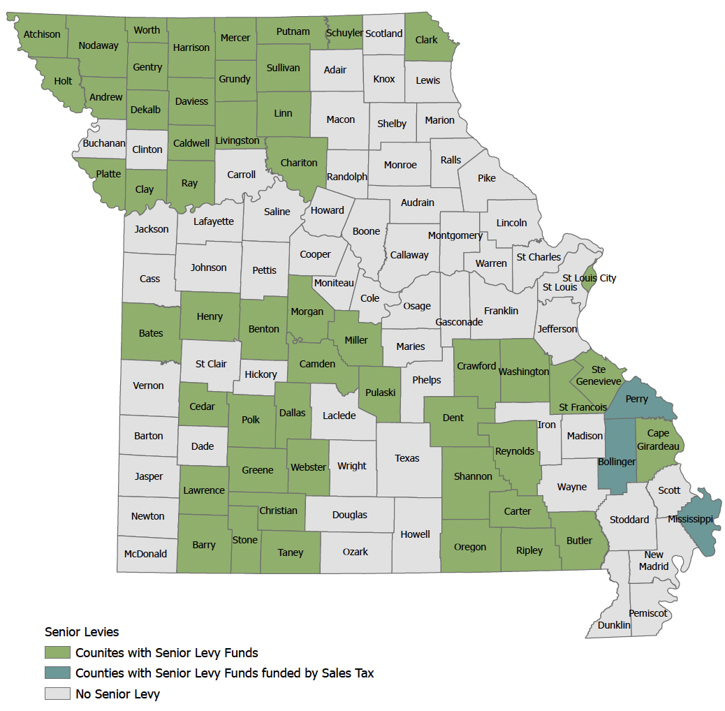
Missouri Counties with Senior Levies
MoALSO Who we are
The Missouri Association of Levy Boards & Senior Organizations (MoALSO) assists and supports current levy boards, members, and other stakeholders through networking and education. MoALSO also provides assistance to groups interested in passing a senior levy in their counties and advocates around state issues impacting older adults.
Notes:
Tina

Slide 7
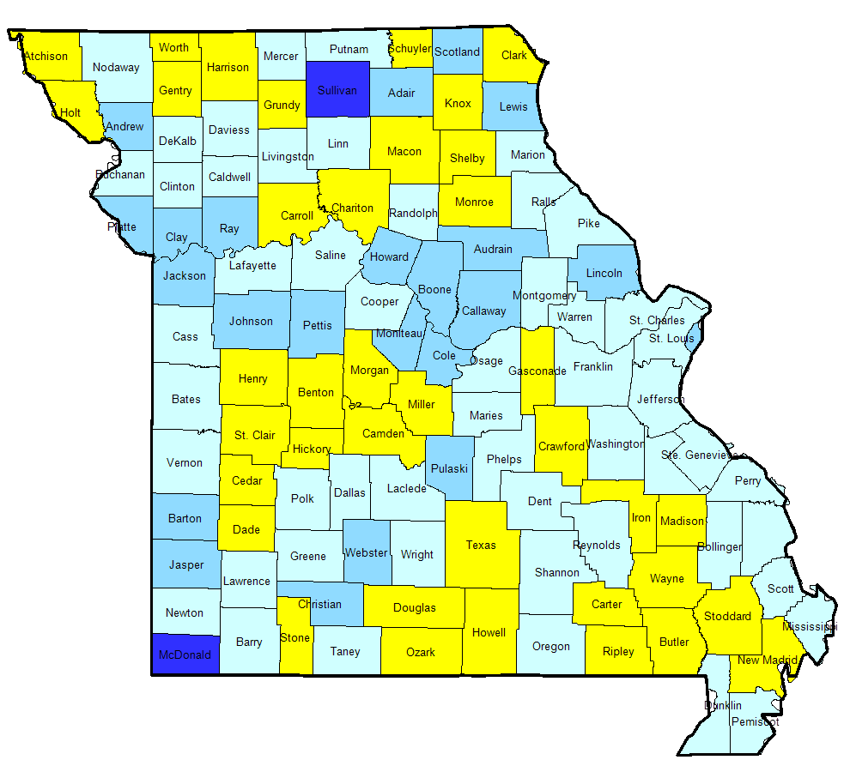
Missouri’s Senior Population
Percent of Population 65+
25% or Greater
20% to 24.99%
15% to 19.99%
10% to 14.99%
Less than 10%
2010
2030
Notes:
Our population is aging rapidly -

Slide 8
Services supported for older residents include:
Home delivered and prepared meals
Senior Center operations
Transportation
Home-safety repair and maintenance
In-home support services
Lifelong learning and exercise programs
Notes:
Debbie

Slide 9
Statewide Collective Impact
More than $16 million is generated across Missouri each year
Leverage Resources: Grantees and partners are able to leverage grants with other funding sources.
Build Capacity: The funds support local operations including personnel costs to deliver programs.
Measure Outcomes: Counties collect data, measure impact and evaluate outcomes and conduct satisfaction surveys from residents.
Foster Collaboration: Opportunities to develop new programs and collaborate with others.
Notes:
debbie

Slide 10
How is the local fund managed locally?
Governed by an independent board of citizens appointed by the county commission
Board sets by-laws, policies, procedures and manages the budget
Each year, the state send county clerk the set levy amount (which has been determined by collections the prior year)
Board sets annual funding priorities and grant guidelines.
Four counties have professional staff.
MoALSO provides support for new counties to help their board develop the governance structure.
Notes:
Debbie/tina chime in

Slide 11
How much can the fund generate in my county?
The law allows counties to collect five cents for every $100 of all taxable property assessed.
If an average home has a value of $100,000 a property owner would pay $9.50 per year.
A taxpayer with an automobile valued at $10,000 would pay $1.67 in personal property tax

Slide 12
Revenues generate vary by county:
County | Assessed Value | Levied | Revenue Generated 2022
Greene County | 5,556,350,195 | 0.0486 | 2,988,900
Platte County | 3,178,796,161 | 0.0457 | 1,510,262
Christian County | 1,523,684,371 | 0.0469 | 765,204
Stone County | 745,268,739 | 0.0482 | 385,401
Bates County | 248,578,511 | 0.0500 | 135,530
Cedar County | 196,197,727 | 0.0497 | 103,040
Notes:
laura

Slide 13
How to calculate the levy amount:
To estimate the amount of revenue generated by a senior levy, you must contact the County Clerk to obtain the total assessed value of real and personal property collected and multiply that number by the levy amount (up to 0.05) and divide that number by 100.
Notes:
Laura

Slide 14
Worksheet:
Notes:
laura

Slide 15
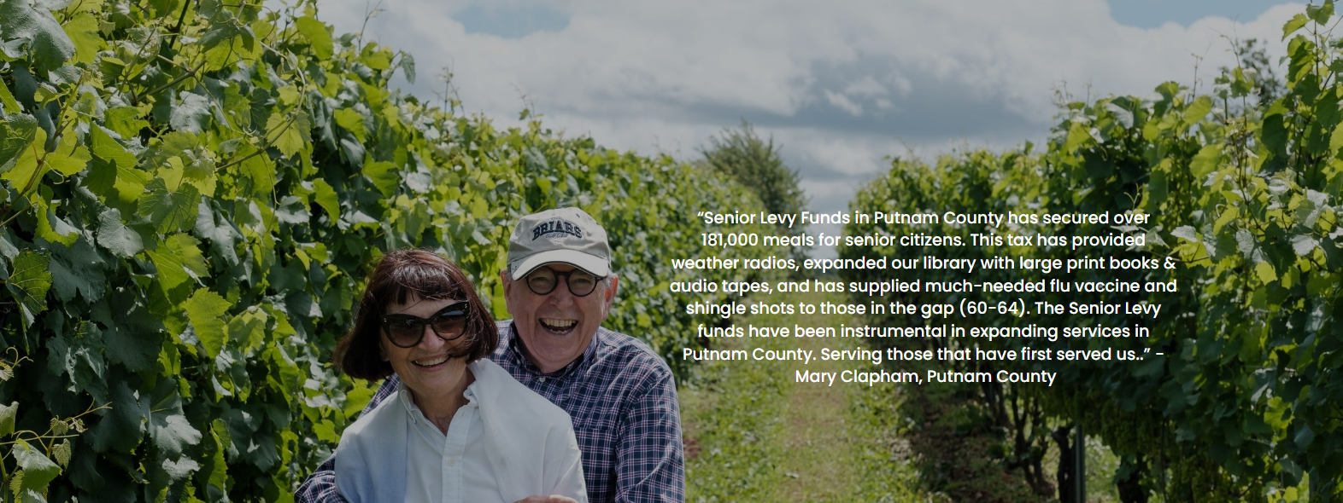
Notes:
Laura

Slide 16
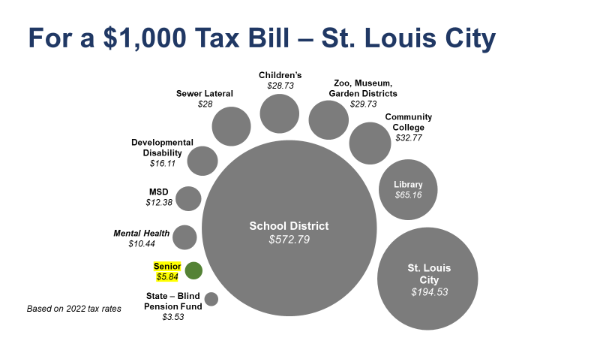
Notes:
Case Studies - Laura Here is an example of how that breaks down for St Louis

Slide 17
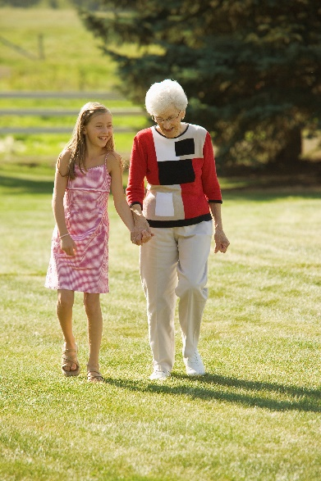
Caregiver Support
Breaktime Club
Together We Care
Northland Grandfamilies Support Group
Co-sponsor caregiver training events with our community partners.
Provide information and resources to help caregivers.
Notes:
VICKI
Breaktime Club is designed to provide a safe, enriching and enjoyable environment for older adults with some physical or mental limitations. It also provides an opportunity for caregivers to relax or take care of personal business, knowing their loved one is in a stimulating program with a professional caring staff. There are two locations, one in Gladstone and one starting up in Liberty.
Together we Care offers a monthly newsletter and quarterly support meetings for those who care for family or friends. Coordinated by Tri County Mental Health and NSC.
Debbie
Breaktime Club is available at Parkville Living Center located at the Parkville Presbyterian Church. Northland Shepherd Center will start a Breaktime Club at Platte Woods Methodist Church in mid April.
Northland Grandfamilies Monthly Support Groups
Monthly support groups will be an opportunity to gather with others who are currently in a kinship role, caring for a younger family member in some capacity. Topics could include legal concerns, financial burdens and emotional or physical stress.
We will feature a variety of speakers in order to provide community resources, coping tips, and guidance on planning for the future. A conference is provided every Fall as well.
To learn more about the Northland Grandfamilies Program call Becky for further details at 816-468-0400 ext 330 or beckyf@tri-countymhs.org.

Slide 18
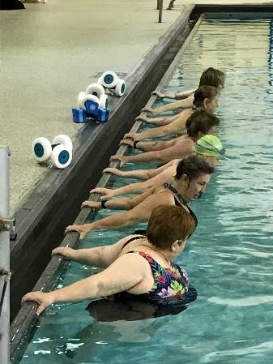
Our Funding Priority Areas
Health & Wellness
Exercise Programs
Senior Centers – Operations
Preventive Health
Public Education
Evidence Based Programs
Notes:
VICKI – Just Read Slide

Slide 19
Where do we start?
Phase One: Build a Coalition of advocates in your community
Area Agency on Aging Director
Philanthropy that support advocacy work
Healthcare professionals and hospitals
Senior Living Facilities
Chamber of Commerce and Business leaders
Faith and community leaders
Civic Leaders and Former Elected Officials
Notes:
Laura

Slide 20
MoALSO can help
Networking
Education on best practices
Advocating
Technical assistance to counties in passing a senior levy fund
Notes:
assists and supports current levy boards, members, and other stakeholders through networking and education. MoALSO also provides assistance to groups interested in passing a senior levy in their counties and advocates around state issues impacting older adults

Slide 21
Notes:
Laura – download the tool kit – hints about how to write an elevator pitch, sample communications with elected officials and media., sample budgets. But we also provide technical assistance.

Slide 22
A few words about the campaign:
The campaign is really the homestretch – 75% of your effort is on the coalition building and last 25% is on the actual political activity.
Develop a communication and campaign plan (examples in the toolkit)
Understand the political landscape – politics is local!
Key messages and educational materials (examples to follow)
Get your message out – get a good “elevator pitch”
Know the basics/benefits of the levy – anticipate the opposition
Notes:
Laura – also mention advocacy

Slide 23
EXAMPLE - Seniors Count Campaign in St. Charles/St Louis

Slide 24
Notes:
Tina

Slide 25
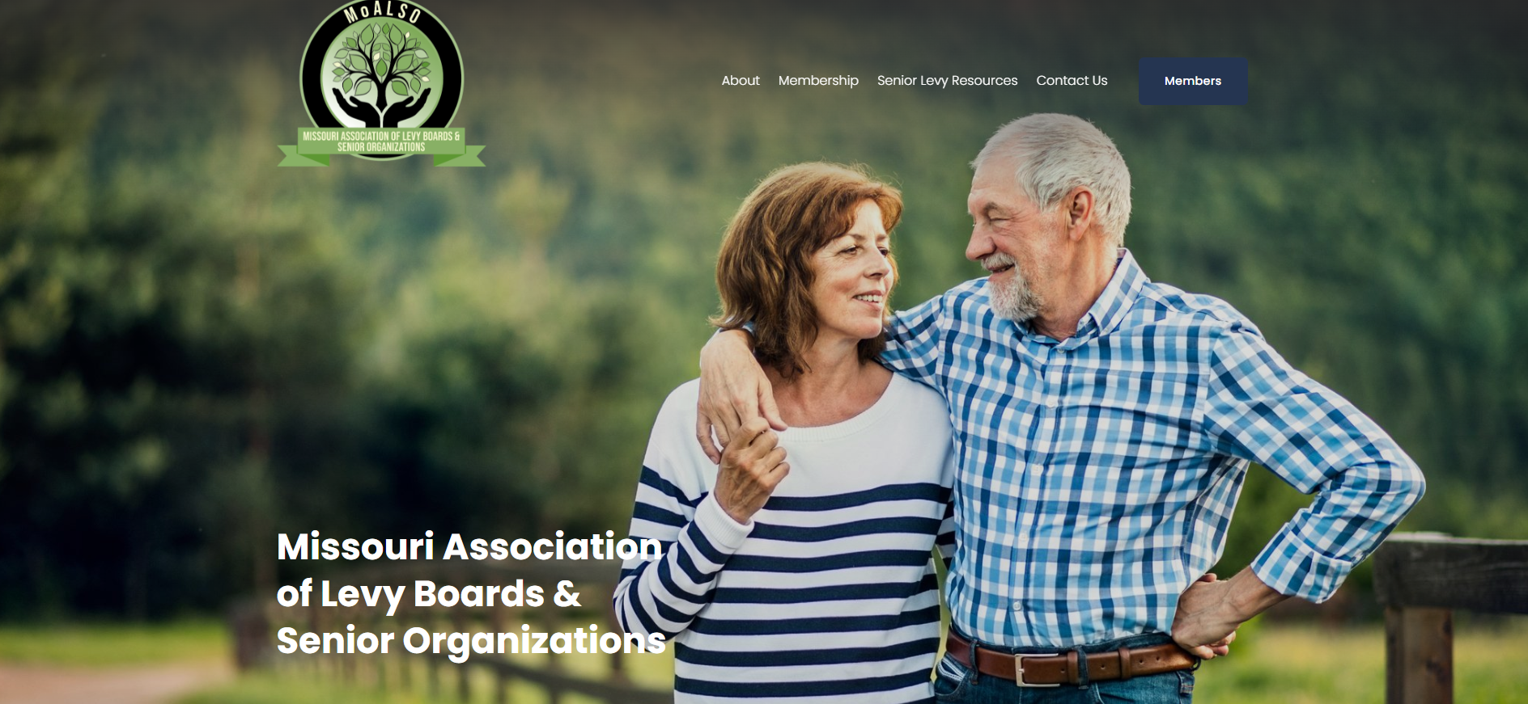
Notes:
Tina

Slide 26
Laura Loyacono
Laura.loyacono@gmail.com
Tina Uridge
tina@claycoseniors.org
Debbie Gwin
dgwin@platteseniors.org
www. moalso.org
Notes:
All end

